Slide 1
3
2
1

Slide 2
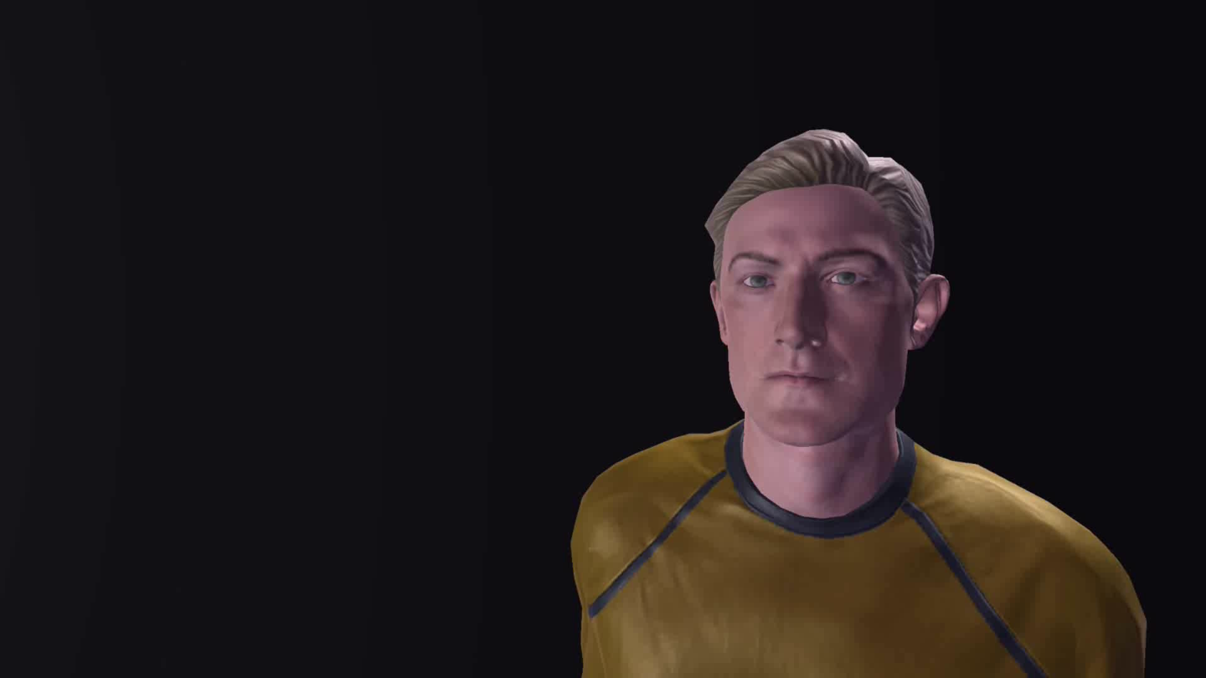

Slide 3


The Development of a Functional Multiplayer Shooter
What is Space Quest 2099?
It’s multiplayer!
It’s fully functional!
It’s a shooter!

Slide 4
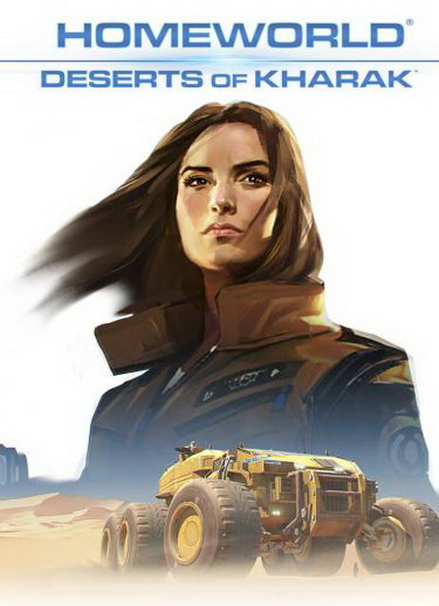
The Inspiration:
The initial inspiration for the project was sparked by a webinar delivered by blackbird interactive.
It discussed the technical problems encountered by the development team in creating a multiplayer aspect for a strategy game.
The game in question was Homeworld: Deserts of Kharak.
Notes:
In the webinar, the team discussed how it would be too intensive to send current state of the game over a network. As a result, exact simulations of the game were run on each client’s computer, and only commands and changes in information were sent to the other players. Whilst this wasn’t strictly what I did, it did peak my interest, and with prior game development experience I was curious about overcoming my own challenges.

Slide 5
The Inspiration:
In the webinar, the team discussed how it would be too intensive to send current state of the game over a network.
As a result, exact simulations of the game were run on each client’s computer, and only commands and changes in information were sent to the other players.
Whilst this wasn’t strictly what I did with my game, it did peak my interest, and with prior game development experience I was curious about overcoming my own challenges.
Notes:
In the webinar, the team discussed how it would be too intensive to send current state of the game over a network. As a result, exact simulations of the game were run on each client’s computer, and only commands and changes in information were sent to the other players. Whilst this wasn’t strictly what I did, it did peak my interest, and with prior game development experience I was curious about overcoming my own challenges.

Slide 6
Section 1:
An Overview of The Game

Slide 7

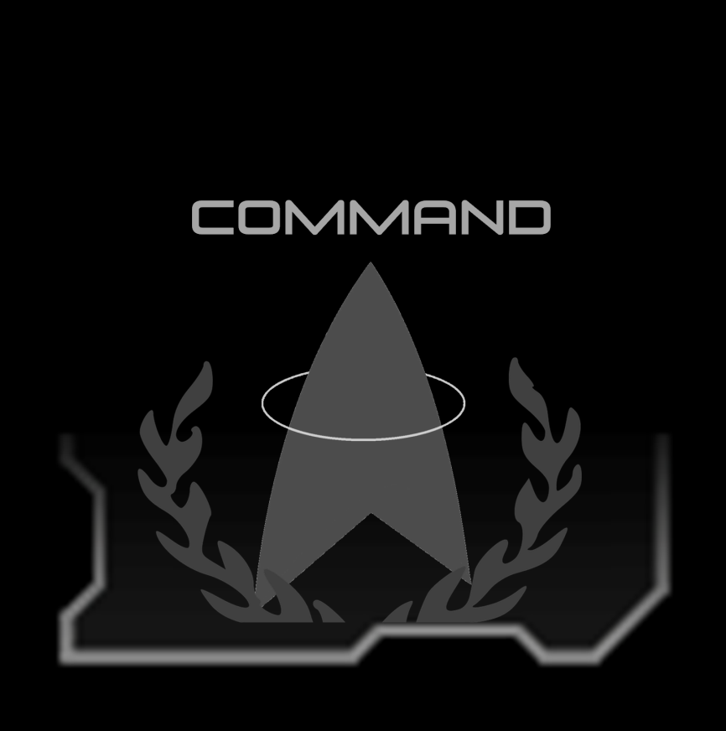
Overview:
unlike Deserts of Kharak, Space Quest 2099 is a team based multiplayer first person shooter created in the Unity Engine.
players join one of two sides (Engineering or Command) comprised of three character classes, each with their own strengths and weaknesses, to battle for control over their ship.

Slide 8
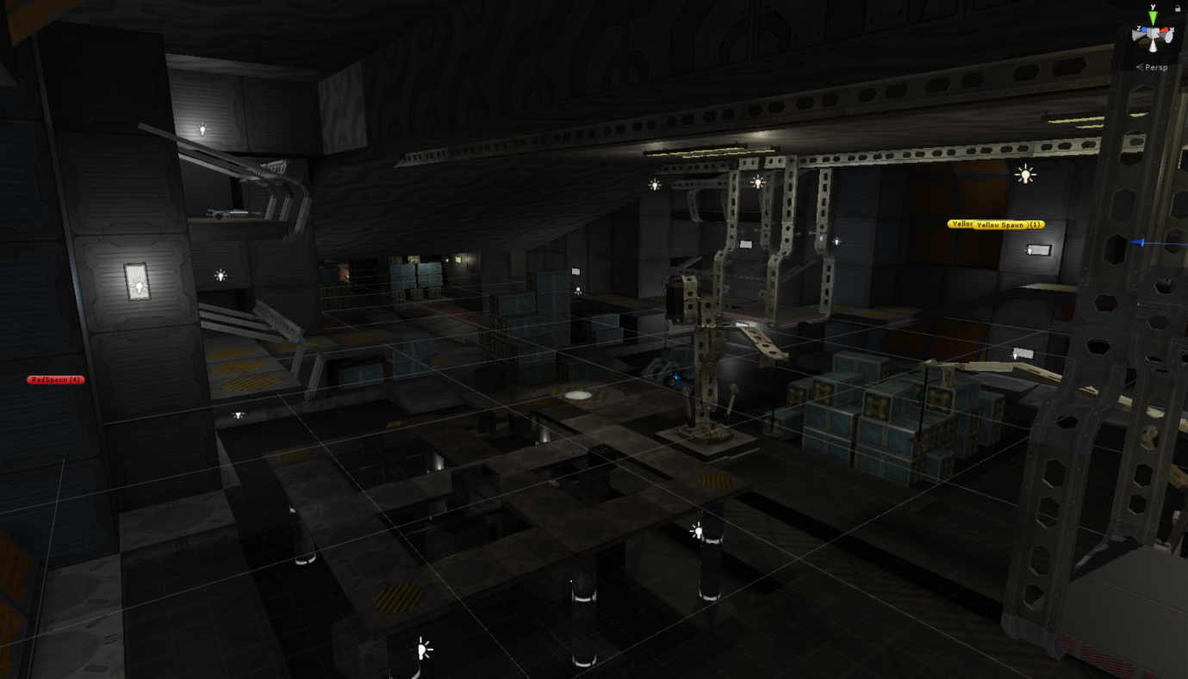
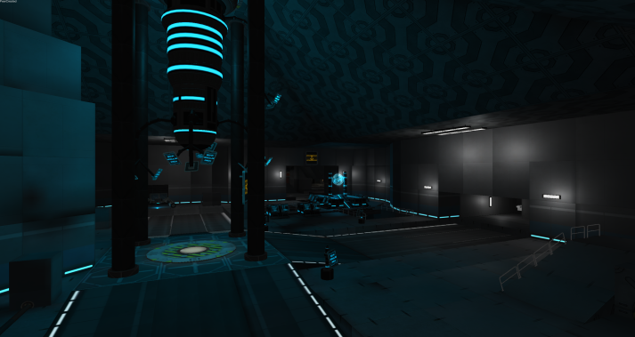
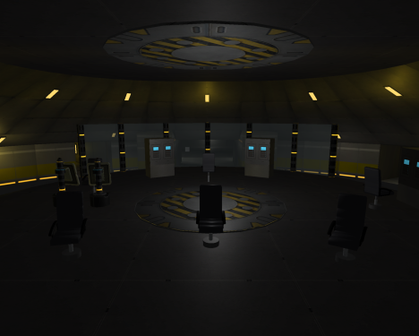


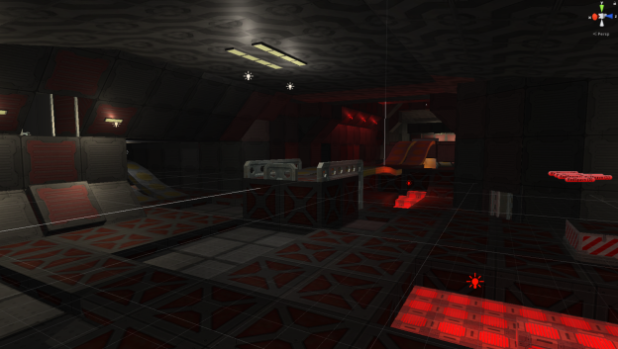
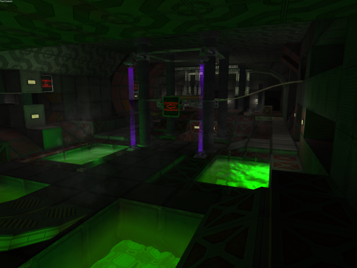
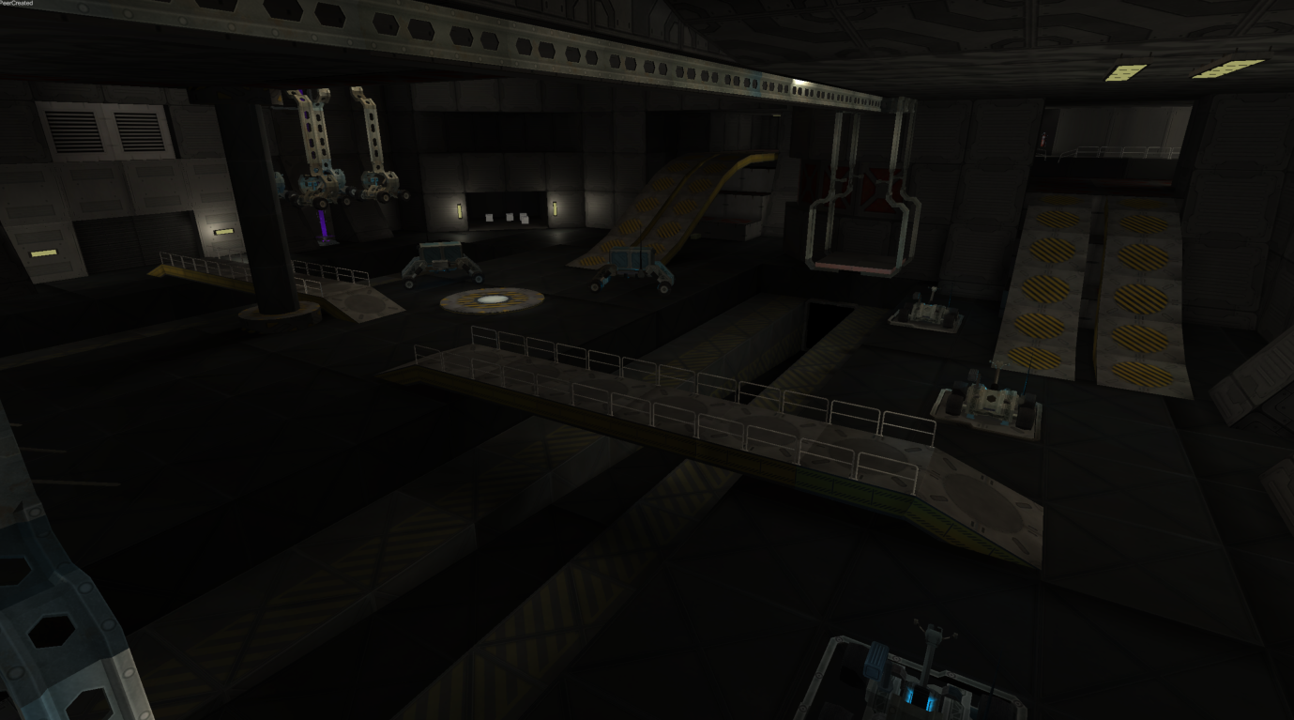
Simplified Ship Map:
Cargo Bay
Computer Core
Command Bridge
Engineering
Waste Disposal
Vehicle Bay

Slide 9
Simplified Ship Map:
Cargo Bay
Computer Core
Command Bridge
Engineering
Waste Disposal
Vehicle Bay

Slide 10
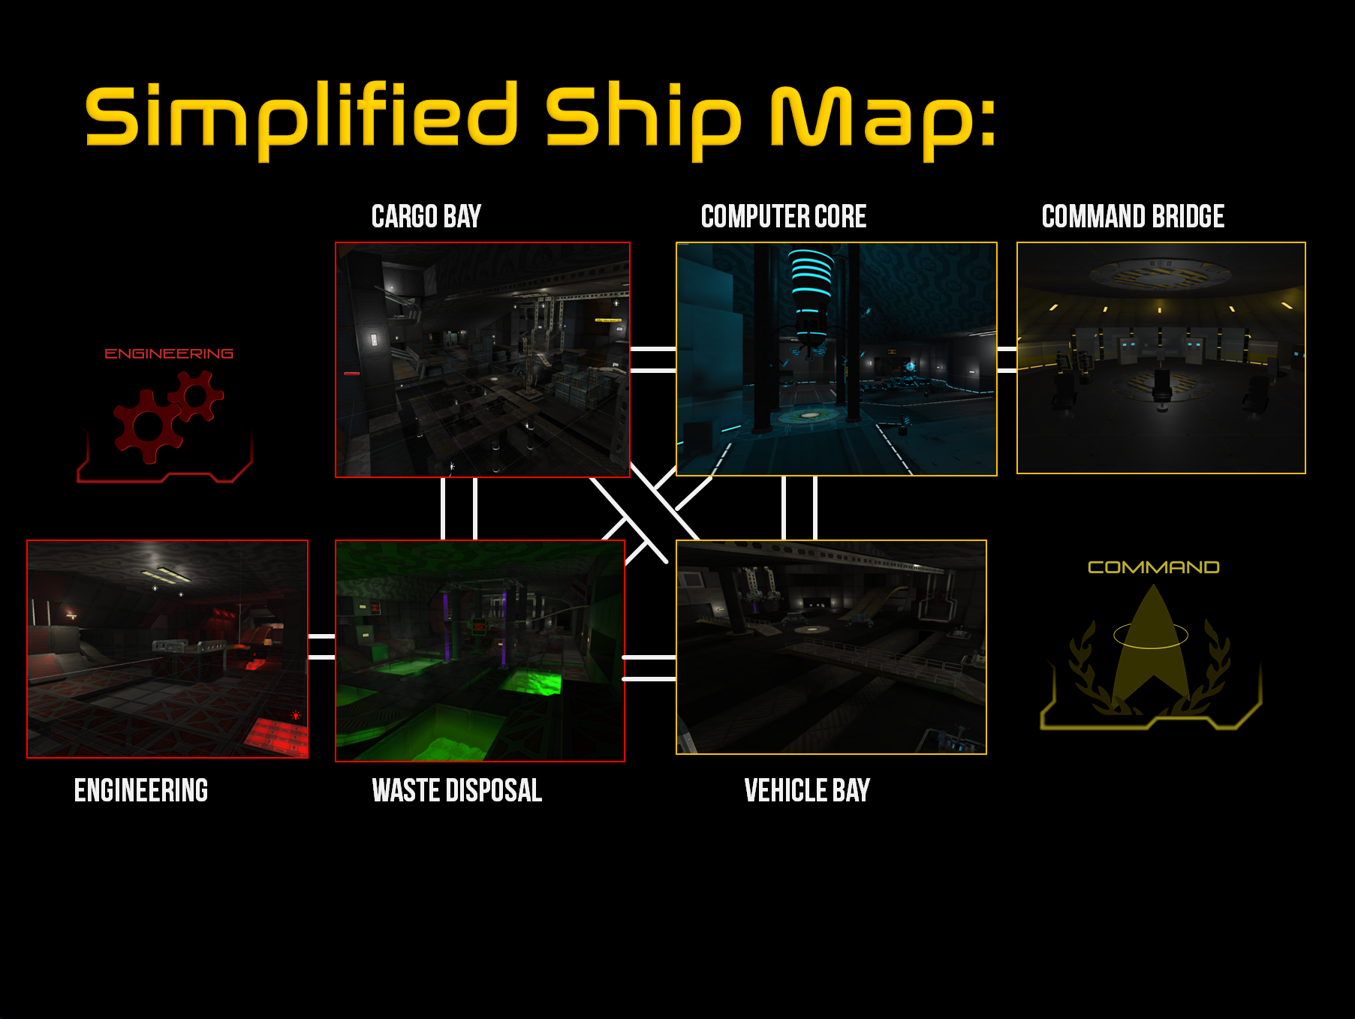
Simplified Ship Map:
Cargo Bay
Computer Core
Command Bridge
Engineering
Waste Disposal
Vehicle Bay
Notes:
Zoom

Slide 11
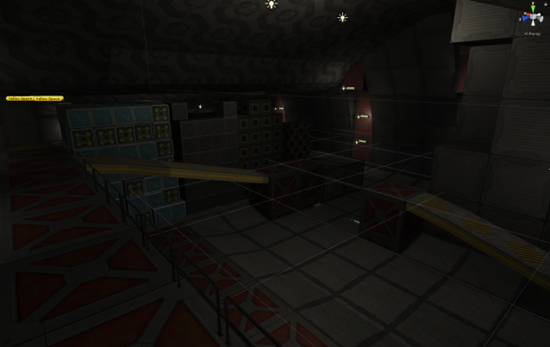
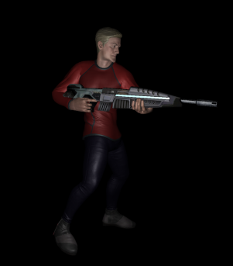
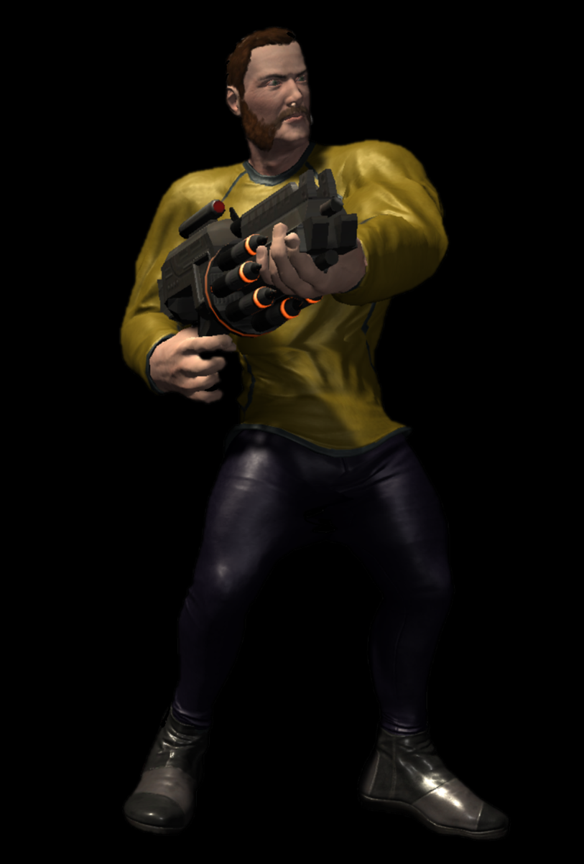

Cargo Bay vs Computer Core:
Cargo Bay
Computer Core

Slide 12
Updated Ship Map:
Cargo Bay
Computer Core
Command Bridge
Engineering
Waste Disposal
Vehicle Bay

Slide 13
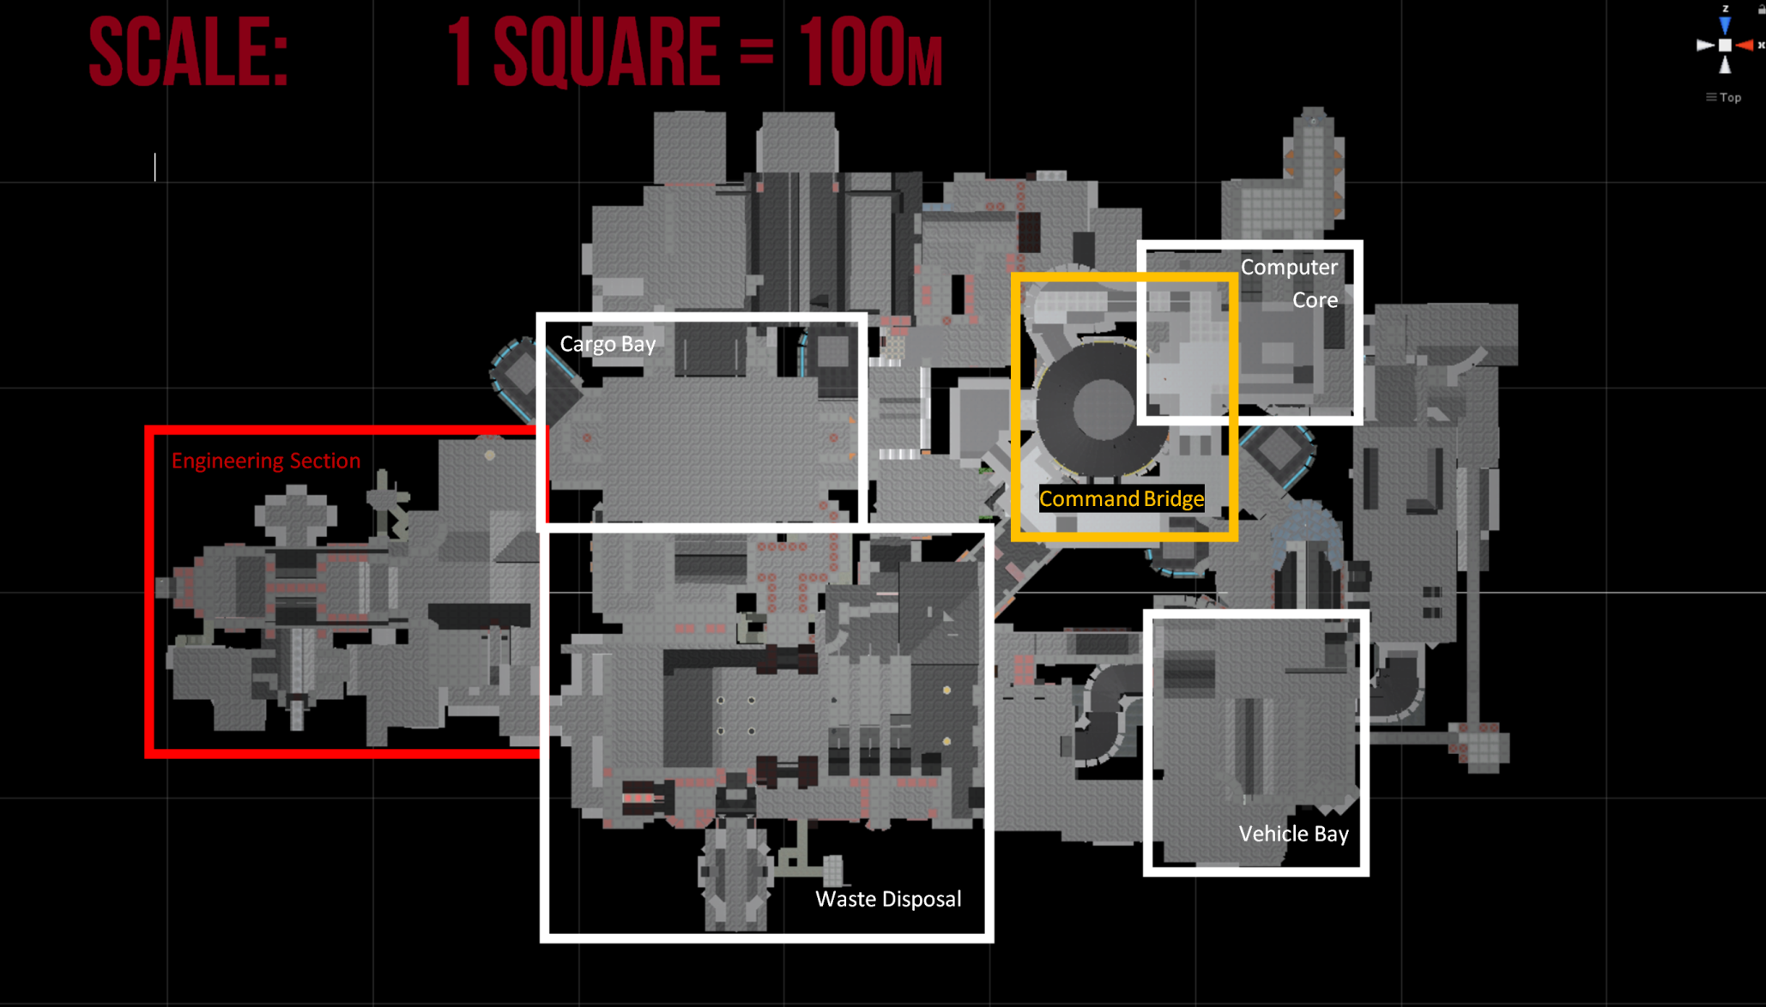
Top-Down Orthographic Ship View:

Slide 14
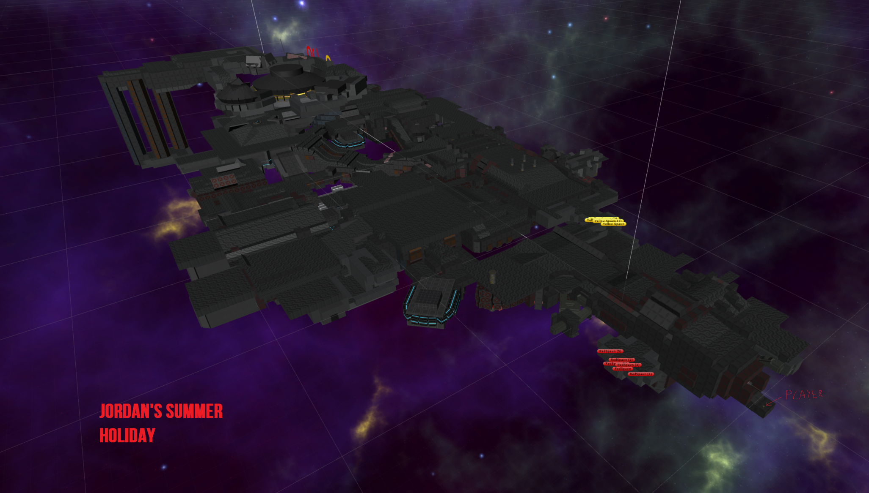
Perspective Ship View:

Slide 15

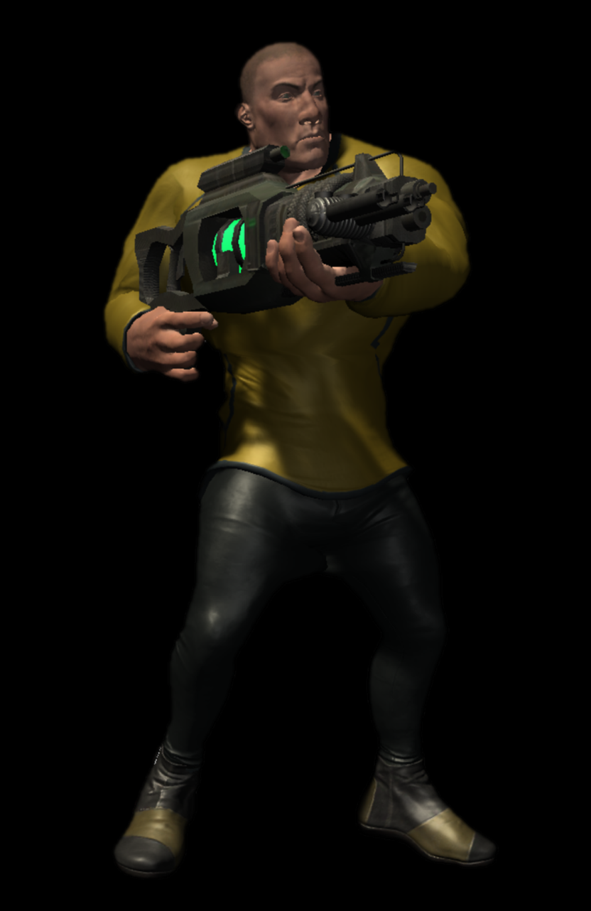
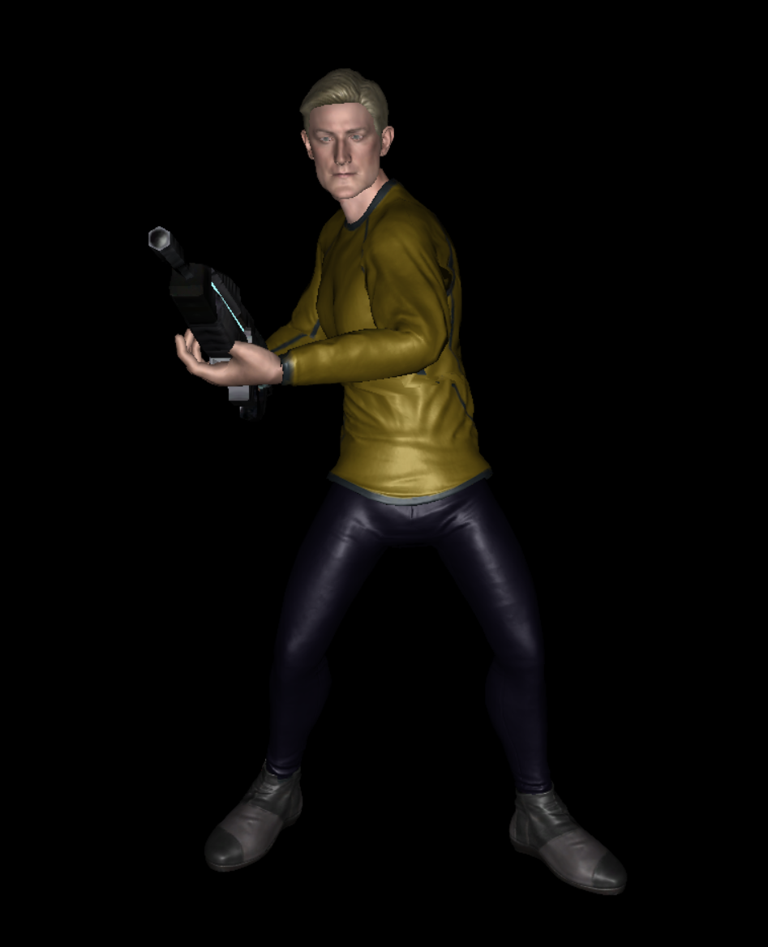
Characters:
Players have a choice of three characters, each with their own unique set of weapons and play style.

Slide 16
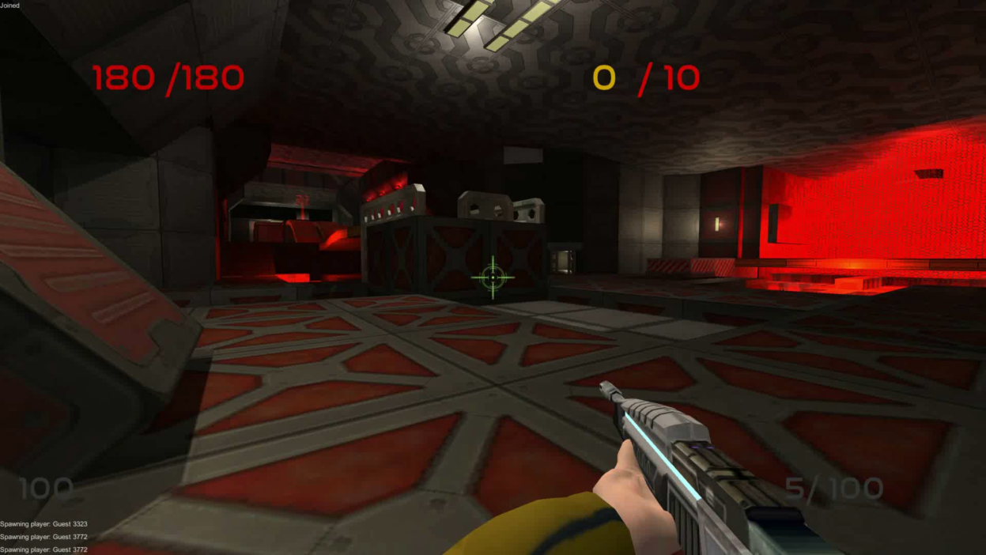
Capt Dave:
Dave is the ‘Lightest’ character. He has the greatest movement speed, but also the least health.

Slide 17
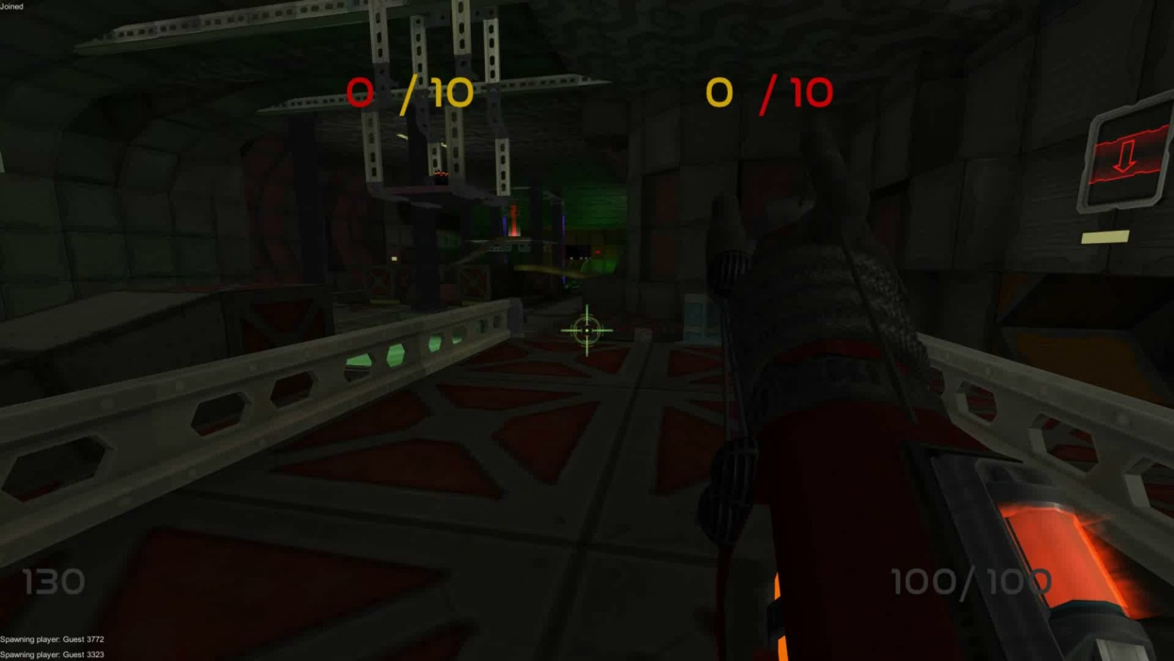
CDR Boris:
Conversely, Boris is the heaviest character in the game, offsetting a slow move speed with a large health pool and the ability to dish out suppressing fire.

Slide 18
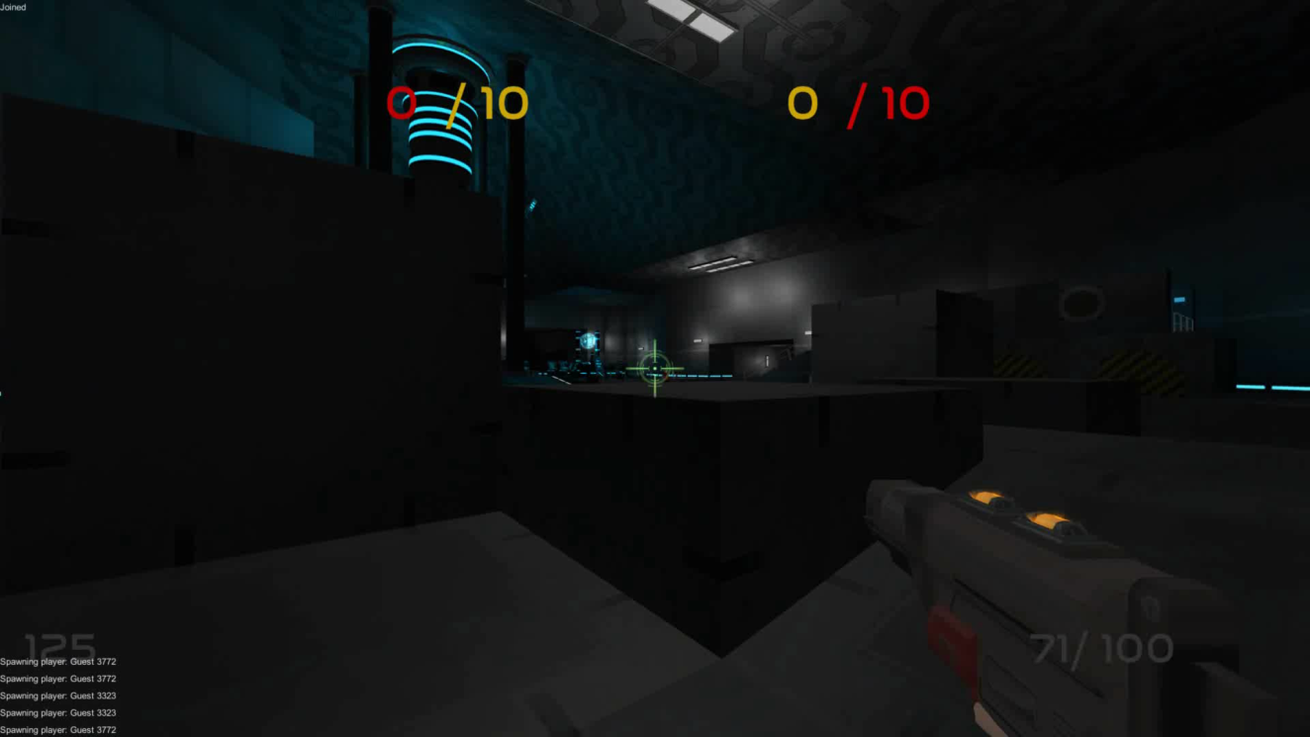
LT Geddon:
Geddon can be seen as the middle ground between the two other characters. He wields an explosive rocket rifle which can blow enemies (or himself) away from the blast.

Slide 19
Section 2:
Research

Slide 20

Research Overview:
Throughout the project, both primary and secondary research was carried out.
The project began with a large amount of preliminary secondary research, supplemented by play-tests throughout development.

Slide 21
Secondary Research:
The first areas of research covered network design and topology as well as level design theory.
This allowed me to begin to formulate technical and creative ideas before starting production.
Firstly, I found an introductory video series created by Martin Glaude.
The series covered the basics of multiplayer games in the Unity Engine.
Consequently, I discovered a powerful unity backend networking development kit – Photon.

Slide 22
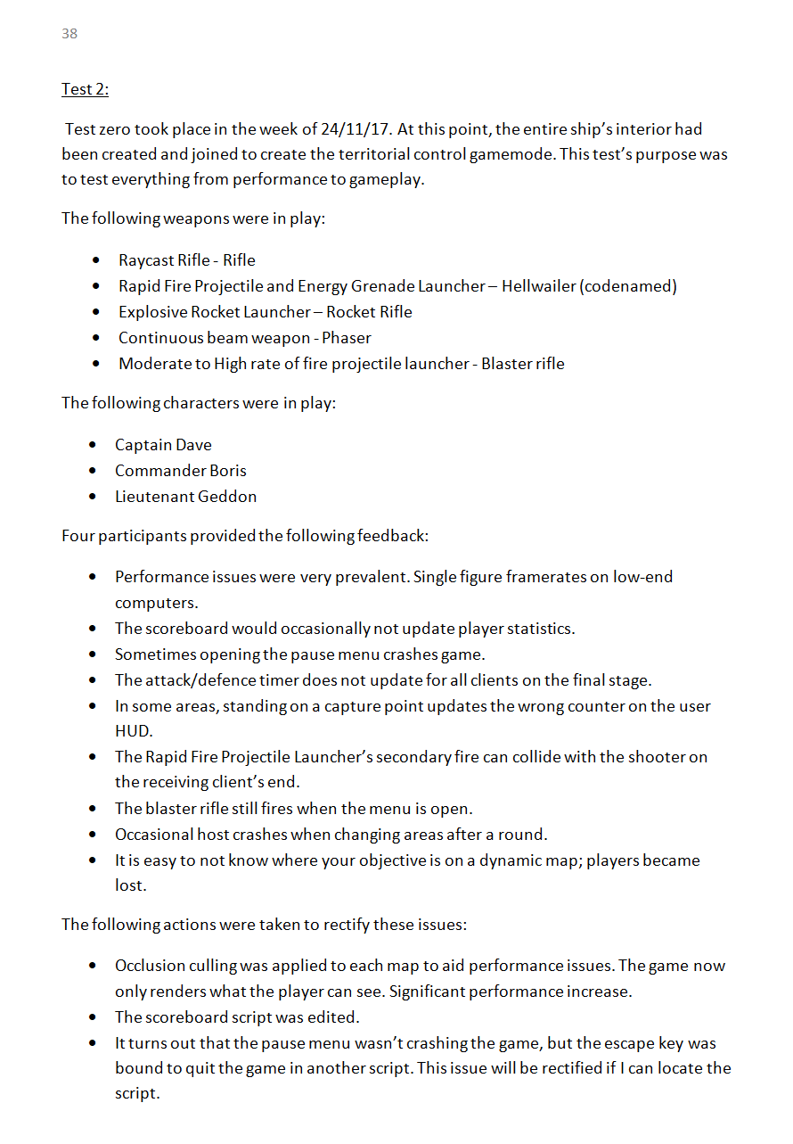
Primary Research:
Primary research took place throughout the development of the game.
After a substantial Update, I would hold a playtest of the current build with a focus group.

Slide 23
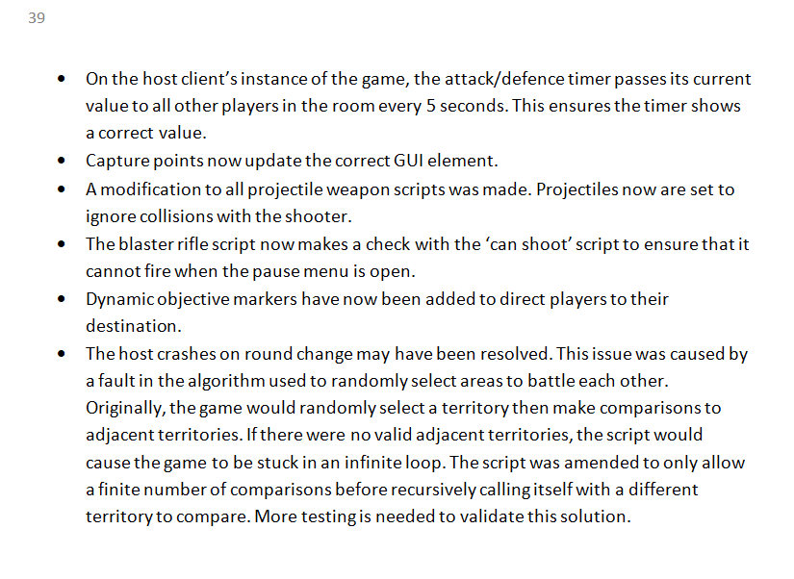
Primary Research:
I would record the opinions of the focus group for compilation into testing reports.
Constructive feedback was followed, and solutions to problems were realised after each test.

Slide 24
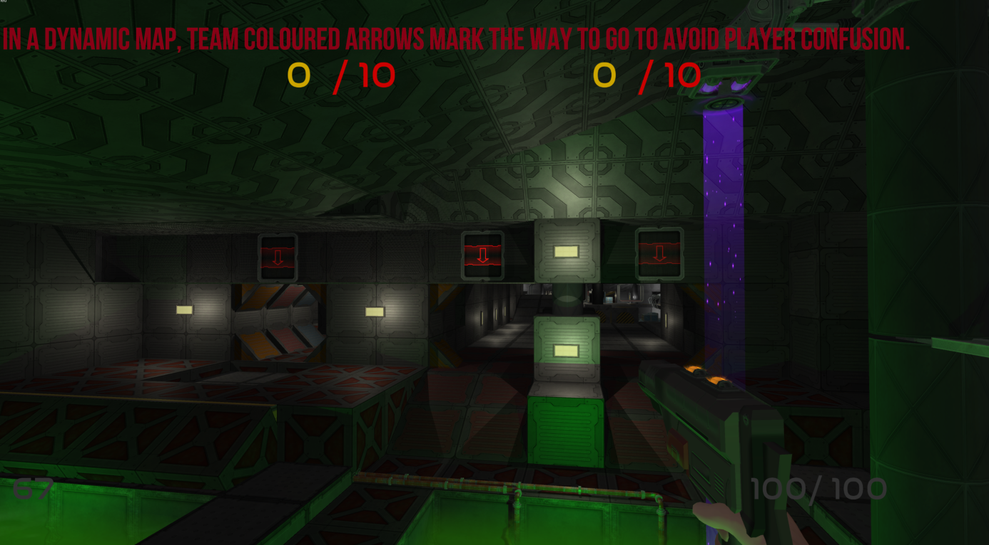
Primary Research in Action:

Slide 25
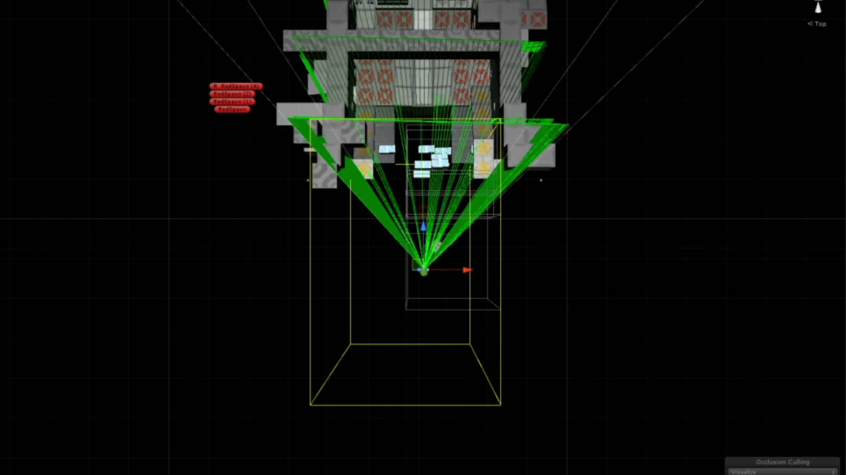
Primary Research in Action:
Occlusion Culling in the cargo bay

Slide 26
Research Evaluation:
The Multiplayer tests and reports were a great success. Many issues were brought to attention and could be rectified.
I believe that the project could have benefitted from a greater variety of source s.
The majority of creative research was drawn from Valve developer commentaries and the ‘on game design’ blog.

Slide 27
Section 3:
Project Reflection

Slide 28
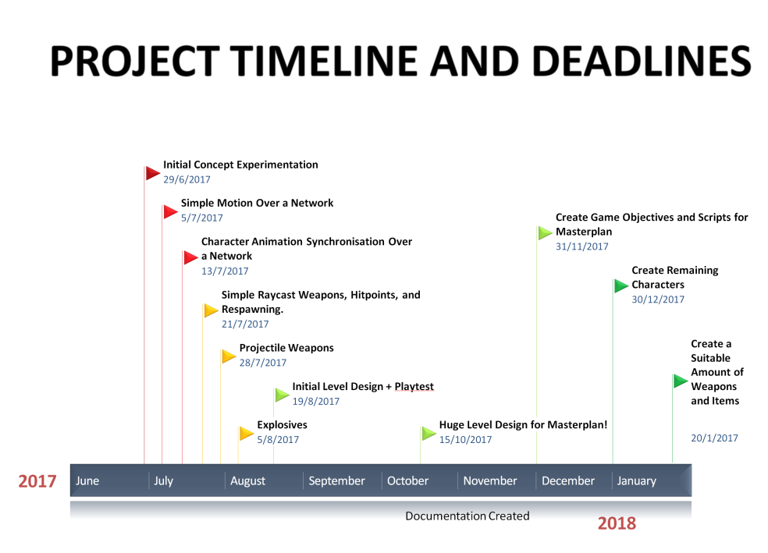
Project Management:
Whilst working on this large extended project, it was essential that time was managed effectively.
It was also important to allow for leeway if extraneous reasons caused for deadlines to be missed.
My primary method of timekeeping
was a project timeline of development.
This timeline featured key deadlines
with proportional areas denoting time
periods.

Slide 29
Project Management:
The project timeline was followed loosely; using the leeway planned into its design - I knew that there would be times at which A-Level work and other commitments would take priority from the extended project
Another example of time management was my reflective progress log.
This allowed me to keep track of tasks that had been completed on a weekly basis, as well as provide a small evaluation to my work, providing a basis for next week’s aims.

Slide 30
What Have I Learnt?:
Various Methods of real-time data transmission, such as serialisation streams and remote procedure calls.
The use of third-party backend development kits (photon) to create a multiplayer framework.
The effective use of character creation and animation software.
Programmatically applying 3d vectors for use in ray-casting algorithms.
Programmatically Applying Euler angles for rigidbody manipulations.

Slide 31
Skill Development:
I feel as if the multiplayer aspect of the game has truly pushed my logical thinking ability. accounting for multiple inputs from clients whilst ensuring that dozens of separate scripts communicate with each other, sometimes remotely, was a difficult challenge.
I believe that my level design skills have greatly expanded as a result of this project.
The fact that each level would be played repeatedly required an extended attention to detail. The fact that this took a few months has certainly had an impact on my patience.

Slide 32

Project Strongpoints:
I consider some of the solutions I have developed throughout the project very effective.
For instance, weapon trajectories work using 3d vectors:

Slide 33
Firing Demonstration:
I consider some of the solutions I have developed throughout the project very effective.
For instance, weapon trajectories work using 3d vectors:

Slide 34

Project Strongpoints:
I also believe that one of the game’s strongpoints is its environmental design.
Red Base - Engineering
This territory adopts a warm colour palate, emphasised by red lighting around key areas such as the capture point; not only bringing these areas to attention but highlighting the fact that players are in the Red base.
Notes:
industrial textures as well as angular geometry were utilised to give the player the feeling that they truly are fighting in the bowels of the ship.

Slide 35
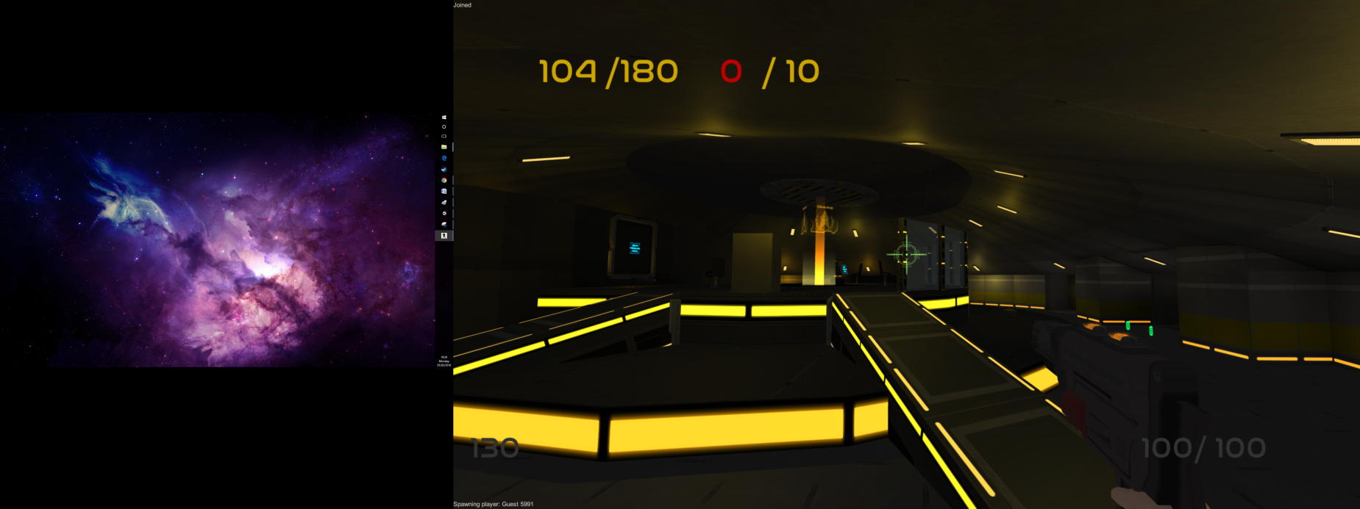
Project Strongpoints:
I also believe that one of the game’s strongpoints is its environmental design.
Yellow Base - Bridge
Smooth walls and round geometry were used extensively in the creation of the bridge, contrasting the industrial and angular design of the Engineering Section with a sleek and professional aesthetic
Notes:
– suggesting to the player that they are far away from Red’s Base and are at the final stage of the match.

Slide 36
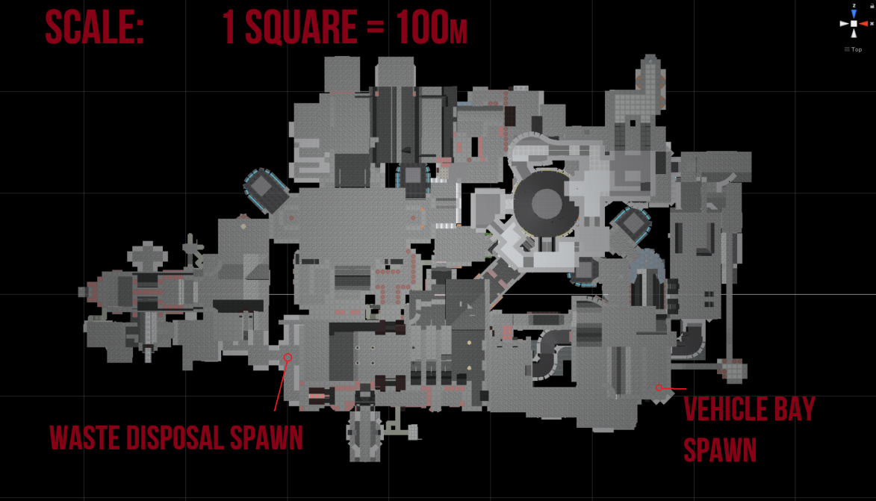
Project Weakpoints:
A major issue with the project was my underestimation the time required to complete
the map.
A large amount of time was dedicated to constructing the map.
The game did not undergo live testing until the entire map was created.
The map can feel too large at times.

Slide 37
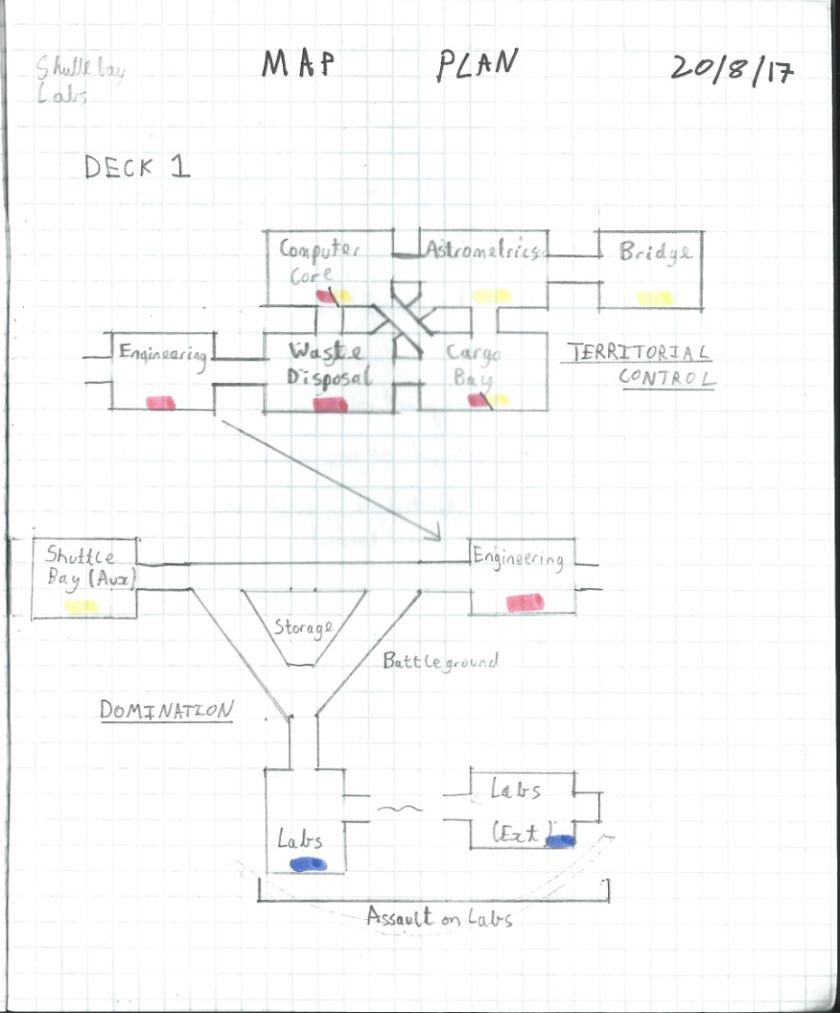
Project Weakpoints:
Time constraints faced in the New Year caused me to scrap plans for several in-development characters as well as the support for a third team.
As can be seen in the early map plan, a separate three team map was planned.
The code and textures for a blue team are in the game files.

Slide 38
Project Weakpoints:
Time constraints faced in the New Year caused me to scrap plans for several in-development characters as well as the support for a third team.
As can be seen in the early map plan, a separate three team map was planned.
The code and textures for a blue team are in the game files.

